Slide 1
Calculating missing side lengths from the area of a trapezium
Perimeter and area

Slide 2
how to use Oak lessons

Slide 3
I can calculate a missing side length from the area of a trapezium.

Slide 4
A trapezium is a quadrilateral with a pair of parallel opposite sides.
The plural of trapezium can be referred to as trapezia or trapeziums.

Slide 5

Calculating missing side lengths from the area of a trapezium
Calculating the area of a trapezium
Finding a missing side length using the area

Slide 6

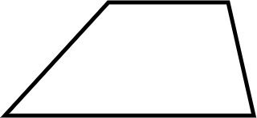
Calculating the area of a trapezium
The formula for calculating the area of a trapezium is
a and b represent the two parallel sides.
h represents the perpendicular distance between the parallel sides.

Slide 7
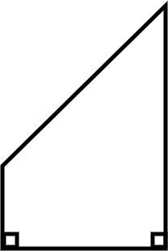
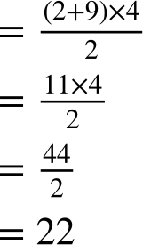
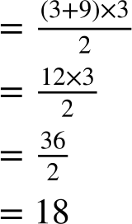
Calculating the area of a trapezium
3 units
7 units
6 units
5 units
9 units
3 units
2 units
9 units
4 units
Area
Area
units²
units²

Slide 8
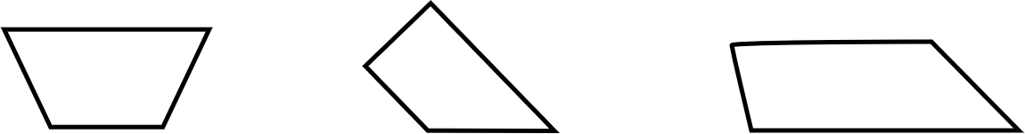
Calculating the area of a trapezium
1) Calculate the area of each trapezium.
a) b) c)
7 cm
2 cm
4.8 cm
5 cm
2.9 cm
2 cm
4 cm
4 cm
2 cm
1.3 cm
2 cm
3 cm
3 cm
6 cm

Slide 9
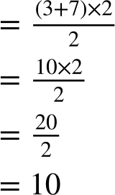
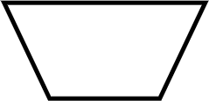
Calculating the area of a trapezium
1) Calculate the area of each trapezium.
a)
7 cm
Area
2 cm
4 cm
4 cm
3 cm
units²

Slide 10
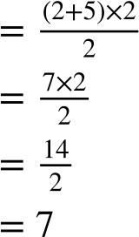
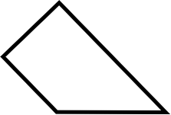
Calculating the area of a trapezium
1) Calculate the area of each trapezium.
b)
Area
2 cm
5 cm
2 cm
3 cm
units²

Slide 11
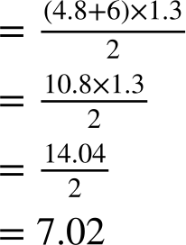
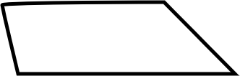
Calculating the area of a trapezium
1) Calculate the area of each trapezium.
c)
4.8 cm
Area
2.9 cm
2 cm
1.3 cm
6 cm
units²

Slide 12
Calculating missing side lengths from the area of a trapezium
Calculating the area of a trapezium
Finding a missing side length using the area

Slide 13
Finding a missing side length using the area
Given the area of a trapezium, it may be possible to calculate a missing side length.

Slide 14

Finding a missing side length using the area
Given the area of a trapezium, you can calculate any missing side length.
The formula for the area of a trapezium only involves the parallel sides and the perpendicular distance between them.

Slide 15
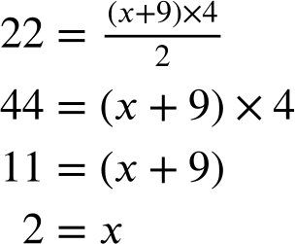
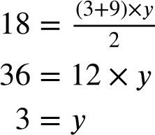
Finding a missing side length using the area
3 units
7 units
Area = 22 units²
6 units
5 units
9 units
y
x
9 units
4 units
Area = 18 units²
The length is 2 units.
The length is 3 units.

Slide 16
Finding a missing side length using the area
1) Calculate the length of the marked side and then, if possible, calculate the perimeter.
a) b) c)
Area = 22 m² Area = 10 cm² Area = 32.64 cm²
8 m
h
d
7 cm
4.9 cm
4 m
5 m
3.4 cm
3 cm
b
4 cm
12 cm

Slide 17
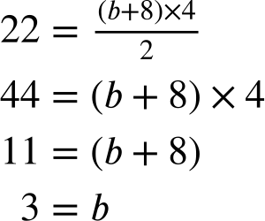
Finding a missing side length using the area
1) Calculate the length of the marked side and then, if possible, calculate the perimeter.
a)
Area = 22 m²
8 m
4 m
5 m
b
The length is 3 m.
The perimeter is 8 + 5 + 5 + ‘3’ = 21 m.

Slide 18
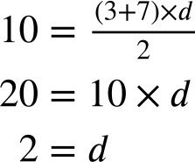
Finding a missing side length using the area
1) Calculate the length of the marked side and then, if possible, calculate the perimeter.
b)
Area = 10 cm²
d
7 cm
3 cm
4 cm
The length is 2 cm.
The perimeter is 7 + 4 + 3 + ‘2’ = 16 cm.

Slide 19
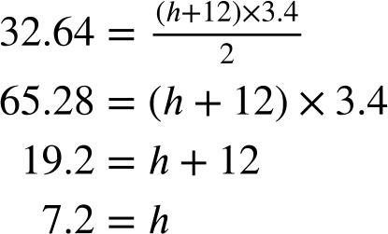
Finding a missing side length using the area
1) Calculate the length of the marked side and then, if possible, calculate the perimeter.
c)
Area = 32.64 cm²
h
4.9 cm
3.4 cm
12 cm
The length is 7.2 cm.
The perimeter cannot be found as one side length is still unknown.

Slide 20
Calculating missing side lengths from the area of a trapezium
The formula for calculating the area of a trapezium is
a and b represent the two parallel sides.
h represents the perpendicular distance between the parallel sides.
The formula can be used to find the length of either parallel side or the perpendicular distance between them.

Slide 21

© Oak National Academy 2024.
Produced in partnership with Mathematics in Education and Industry.
Licensed on the Open Government Licence v3.0, except where otherwise stated. See Oak terms and conditions.

